Slide 1


HackAIthon – Topic #4
DXTBidMasters
CAREER UPSKILLING AGENT
JUNE, 2025

Slide 2
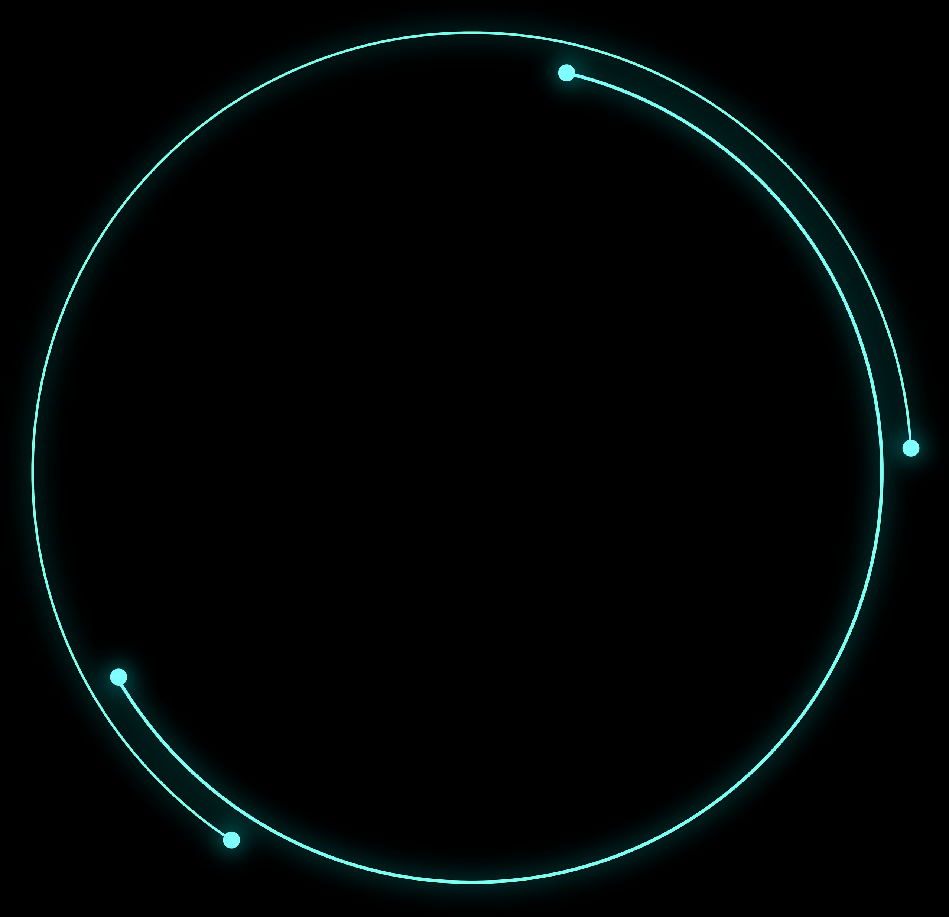


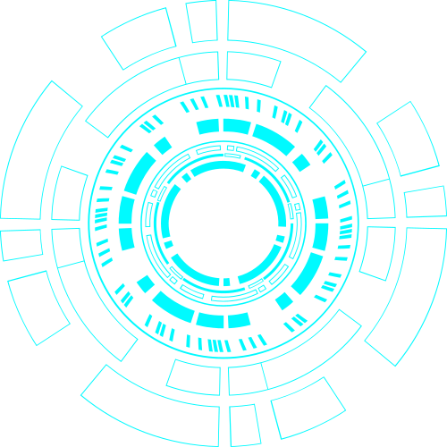
Competition Context
Vision & Success Criteria
Project introduction structure
AI Capabilities & RAG Use
System Architecture & Tech Stack
Progress
Demo Preview
Conclusion

Slide 3


1.
Competition Context
Objective:
Build an AI-powered personal learning agent that creates highly customized learning paths using user inputs and dynamic public resources.
Paint Points
Too many scattered resources, no clear structure.
Difficulty turning current and future skills into a roadmap.
Time-consuming to find quality and relevant content.
No tool to dynamically track and update the plan.
Context:
Rapid tech evolution requires continuous upskilling.
Overwhelming online content makes it hard to plan learning efficiently.

Slide 4
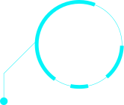

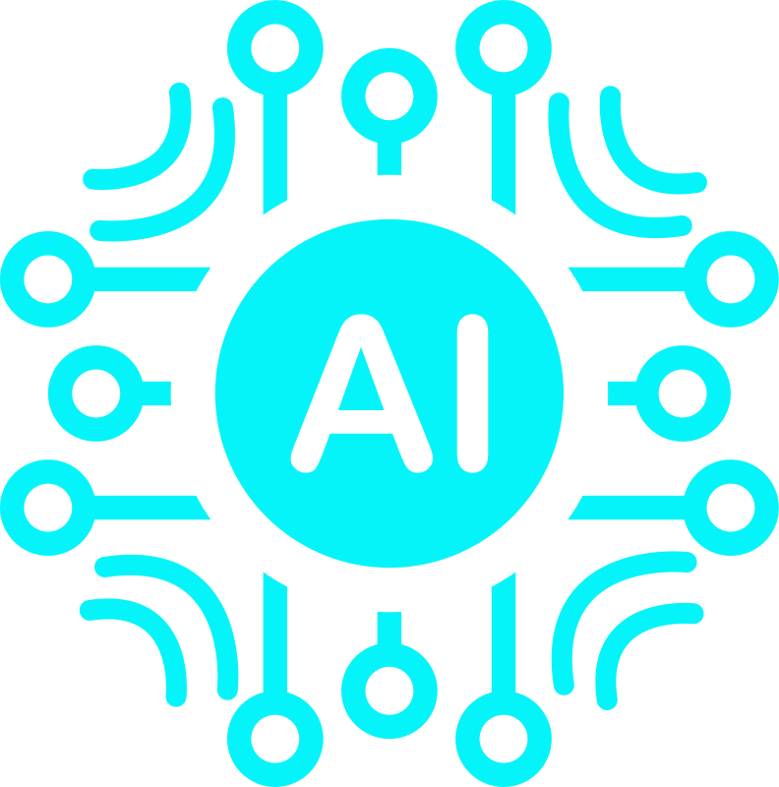
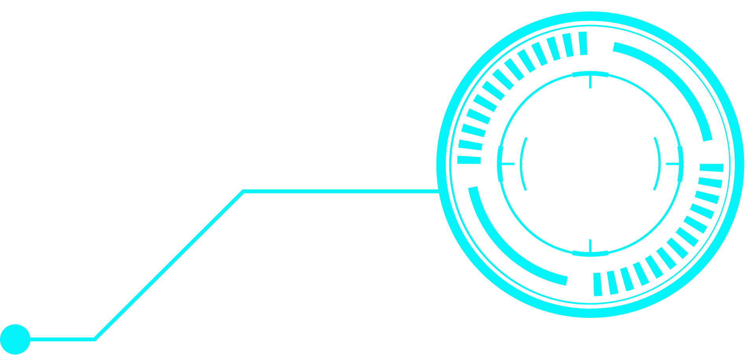
Goals:
Create an AI agent that generates personalized learning roadmaps.
2. Vision & Success Criteria
Input:
Current skills and level
Target skills and level
Time constraints (e.g., 3 months, 10hrs/week)
Output:
Structured learning roadmap (Gantt/Mindmap)
Resource modules (Coursera, Udemy, etc.)
Progress tracking dashboard

Slide 5
3. AI Capabilities & RAG Use
AI Involvement
Analyze user input
Design the roadmap
Recommend personalized content
Monitor progress and adapt
RAG (Retrieval-Augmented Generation)
Retrieval: AI searches for latest and relevant document resources
Generation: Combines retrieved data to create updated, context-aware learning plans

Slide 6

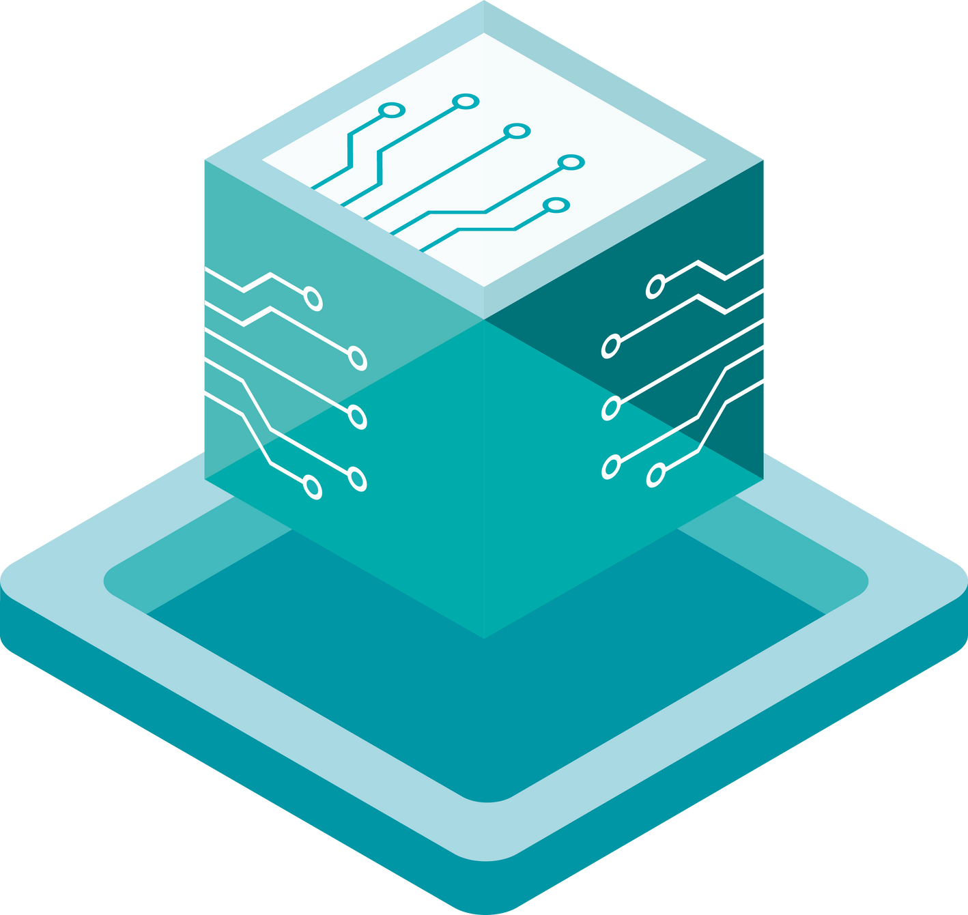
User inputs their goal (e.g., "Learn Backend Development").
User
Journey
User sets a deadline and chooses time commitment per week.
User chooses one:
a) Use profile & past roadmap for skill assessment.
b) Manually select related skills.
AI reviews and confirms skills that the user currently has.
AI generates a personalized roadmap based on goal, timeline, and skills.

Slide 7
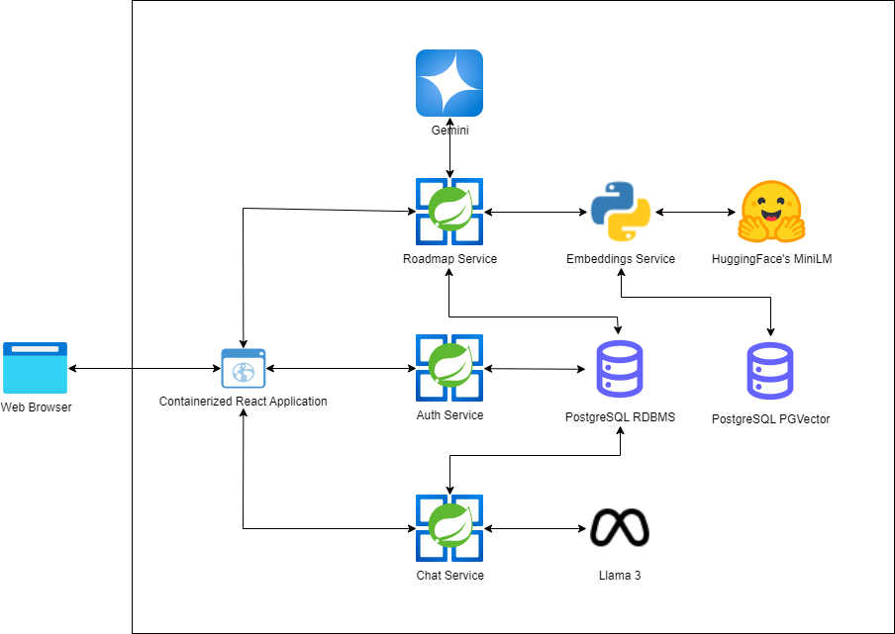
4. System Architecture & Tech Stack
System Architecture

Slide 8
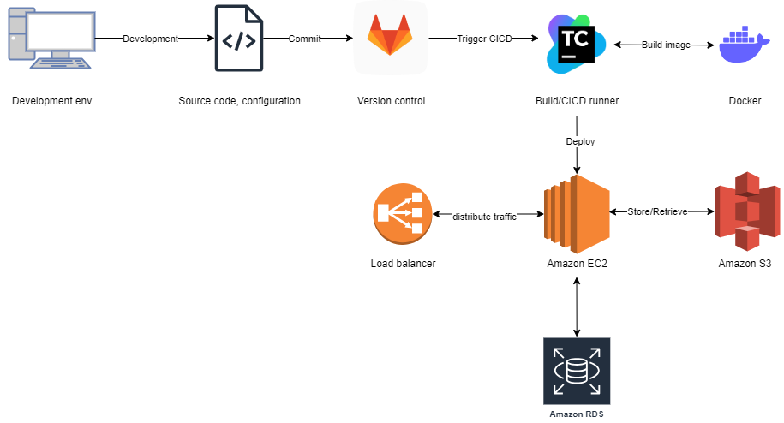
Deployment Diagram

Slide 9











4. System Architecture & Tech Stack
Technology Stack
Front-end | Back-end | AI Model | Database

Slide 10
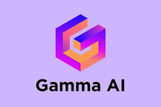



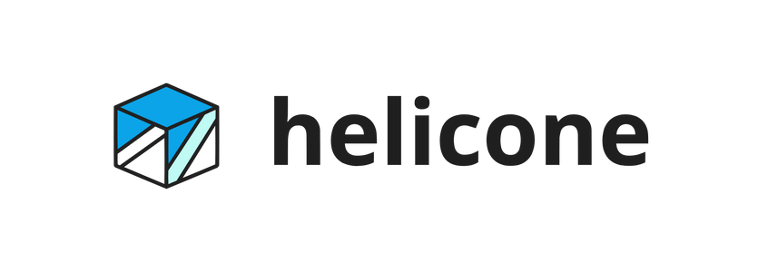


4. System Architecture & Tech Stack
Tool | Primary Task(s)
 | Slide/Presentation Generation, Documentation Sketches.
 | Generate AI-Powered Pitch Decks.
 | Code Suggestion, Refactoring, Automation.
 | Project Documentation, Planning & Task Lists, Idea Generation.
 | Cost Monitoring, Token Usage Tracking, Prompt Debugging.
 | AI Diagram Generation, System/Architecture Mapping.
 | Brainstorming, Prompt Writing, Documentation, Code Help.
OpenAI Tokenizer | Token Estimation, Prompt Length Control.
Al related tool

Slide 11

5.
Project Management & Progress
Stage 1 - Requirement & System Design
Stage 2 - Prototype Development
Stage 3 - Enhancement & Integration
Integrate mock RAG-based recommendations
Add progress tracking & roadmap updates
refine UI for demo
Analyze BRD and define MVP scope
Identify key inputs/outputs
Draft system architecture & user flows
Create task board & plan milestones
Build input form and initial backend API
Generate static learning roadmap (mock data)
Implement basic UI & roadmap visualization
Deploy initial serverless infra

Slide 12
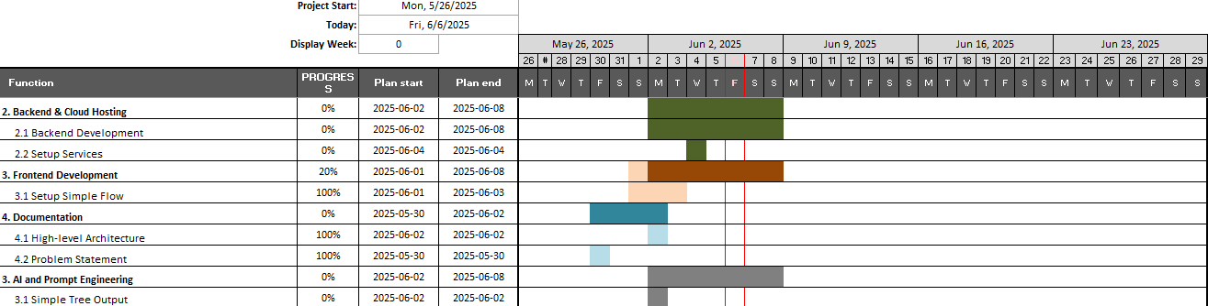
5.
Project Management & Progress
Master plan

Slide 13
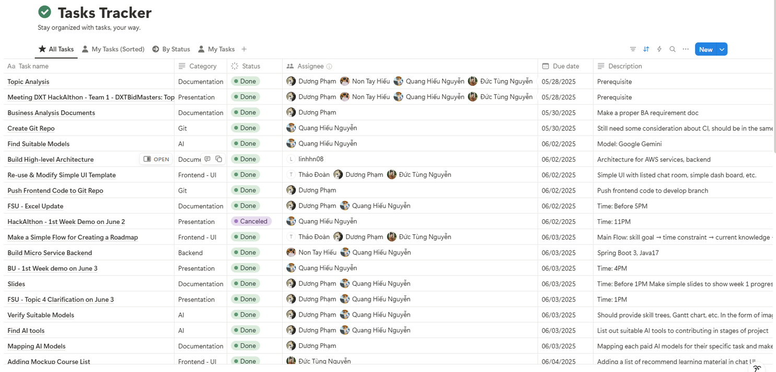
5.
Project Management & Progress
Task board

Slide 14
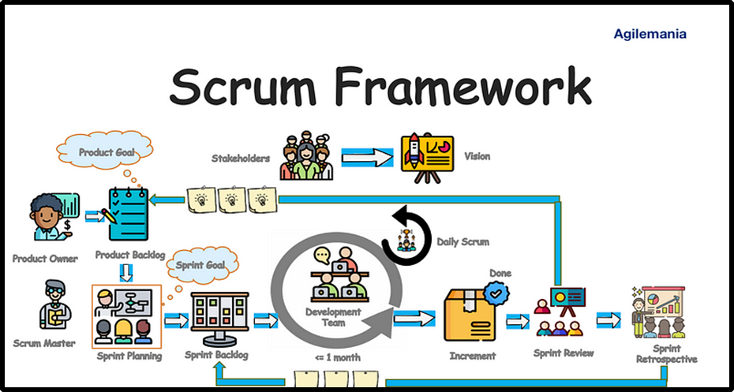
5.
Project Management & Progress
Methodology

Slide 15

6.
Demo preview

Slide 16
7.
Conclusion

Slide 17

Why Choose Our Solution?
Seamless User Experience
Built for Scale
Smart Content Retrieval (RAG)
Personalized & Adaptive
AI-Driven Efficiency

Slide 18

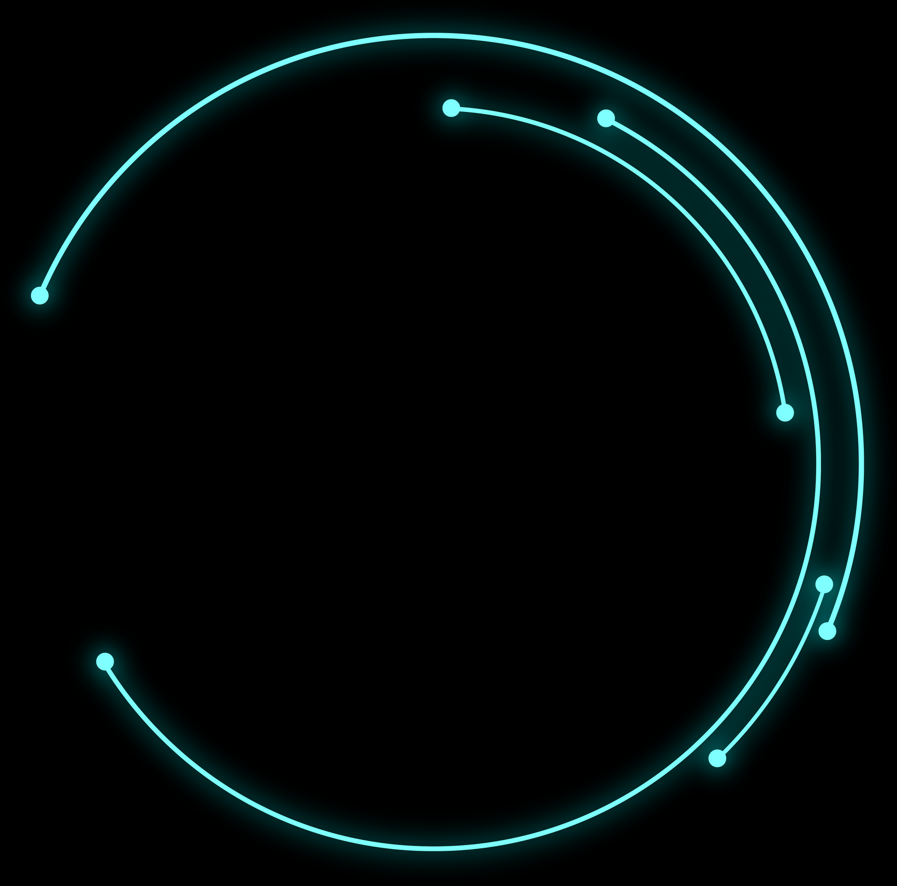
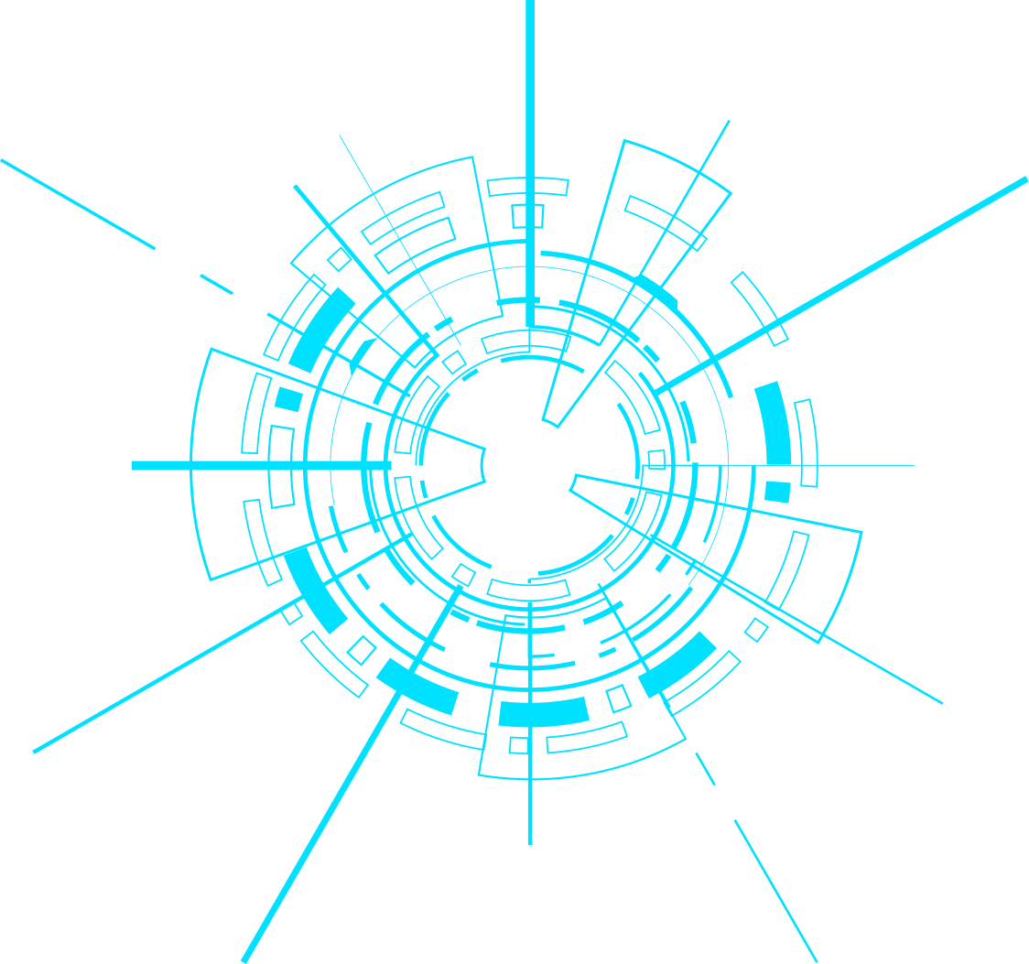
THANKS FOR WATCHING
Presentation by DXTBidMasters team

